Slide 1
Lecture 7: Microsoft .NET
EC3307:Object & Component Technology

Slide 2
Questions
When and who introduced .NET technology?
Why .NET was introduced?
What are the advantages of using .NET technology?
List some of the programming languages supported by .NET.
What is IL (Intermediate Language)?

Slide 3
What is .NET?
Definition: A programming infrastructure created by Microsoft for building, deploying, and running applications and services that use .NET technologies, such as desktop applications and Web services.

Slide 4
What is the .NET Framework?
The .NET Framework is a revolutionary platform created by Microsoft for developing applications
It is a platform for application developers
It is a Framework that supports Multiple Language and Cross language integration.
IT has IDE (Integrated Development Environment).

Slide 5
Framework is a set of utilities or can say building blocks of your application system.
.NET Framework provides interoperability between languages i.e. Common Type System (CTS) .
.NET Framework also includes the .NET Common Language Runtime (CLR), which is responsible for maintaining the execution of all applications developed using the .NET library.
The .NET Framework consists primarily of a gigantic library of code.

Slide 6
.Net Framework
The .NET Framework has two main components:
the common language runtime environment
the .NET Framework class library.

Slide 7
Run-time environment
Run-time environment offers
automatic garbage collection,
security mechanisms,
version control,
interoperability between programs written in different programming languages.

Slide 8
Object-Oriented class library
Provides a rich set of functionality for
Graphical User Interfaces (Windows Forms & WPF)
Web Interfaces (ASP.NET Core)
Database Connectivity (Entity Framework Core & ADO.NET)
collection classes
threads
reflection
. . . and much more.
The .NET Framework has evolved, and Microsoft has transitioned to .NET (formerly .NET Core) as the modern, cross-platform framework.

Slide 9
Open platform – Uniform Technology
Technology has evolved significantly, and modern application development now follows a unified, cross-platform approach.
Internet applications (eg Web Shops) uses different technology from desktop applications:
Desktop applications
compiled languages
use object-oriented class libraries and frameworks.
Web applications are written in
HTML
ASP
CGI
interpreted languages: JavaScript or PHP.

Slide 10
Desktop Applications
Programming Languages:
Traditional: C++, Pascal (less common now)
Modern: C# (.NET), Java, Swift (macOS/iOS), Kotlin (Android), Python (for some GUI apps)
Frameworks & Libraries:
.NET (Windows Forms, WPF, .NET MAUI) – Used for Windows and cross-platform apps.
Electron.js – Uses web technologies (HTML, CSS, JavaScript) for desktop apps (e.g., Slack, VS Code).
Qt (C++) – Cross-platform GUI applications.
JavaFX – Used for Java-based desktop applications

Slide 11
Web Applications
Front-end Technologies:
HTML, CSS – Still essential for UI.
JavaScript (ES6+) – Modern JavaScript frameworks dominate:
React.js, Angular, Vue.js – For dynamic, interactive web applications.
Blazor (C#) – Allows full-stack C# development.
TypeScript – A strongly typed version of JavaScript, widely adopted.

Slide 12
2.Back-end Technologies
ASP.NET Core (C#) – Modern alternative to classic ASP.
Node.js (JavaScript/TypeScript) – Popular for scalable applications.
Python (Django, Flask) – Common in web development.
PHP (Laravel, Symfony) – Still used, but declining in new projects.
Java (Spring Boot), Ruby on Rails, Go – Other popular backend frameworks.

Slide 13
3.Web APIs & Backend Connectivity:
RESTful APIs – Standard for communication between front-end and back-end.
GraphQL – More flexible alternative to REST.
WebSockets – Real-time applications (e.g., chat apps).

Slide 14
4.Server-side Rendering (SSR) & Static Site Generators (SSG)
Next.js (React) – For optimized server-side rendering.
Nuxt.js (Vue) – Similar for Vue.js.
Hugo, Gatsby – Static site generation

Slide 15
Key Modern Trends
Cloud Computing – Web apps are now often hosted on cloud platforms like AWS, Azure, or Google Cloud.
Progressive Web Apps (PWAs) – Combine web and native app features for a better user experience.
Cross-Platform Development – Tools like .NET MAUI, Flutter, and React Native allow building both mobile and desktop apps with one codebase.

Slide 16
Open platform – uniform technology
With .NET the two styles of applications can be developed with the same techniques: C# or Visual Basic .NET + comprehensive object-oriented class library.

Slide 17
Interoperability
Organizations invested money in software developed in C++, Visual Basic or Fortran
programs in different languages working together smoothly.
.NET offers unprecedented interoperability.
While the runtime is designed for the software of the future, it also supports software of today and yesterday.

Slide 18
Interoperability
Recently there has been a huge growth in the use of small computers
hand-helds
palmtops
Systems with embedded micro-controllers.
Special languages and operating systems have been developed for them
In .NET they can be programmed with the same languages and libraries as PC’s and web servers
Allows the development of software for mobile and embedded systems to move closer to conventional programming.

Slide 19
Distributed systems
.NET offers:
Web-Services which are implemented by means of
remote procedure call
XML
HTTP
Visual Studio .NET
multi-language development environment
debugger
GUI designer: Web Forms or Web Services.

Slide 20
Under .NET Microsoft also subsumes various servers:
Windows Server
Originally known as Windows 2000 Server, this operating system has undergone multiple iterations. The latest version, Windows Server 2022, offers enhanced security, hybrid capabilities with Azure, and improved performance features.
SQL Server (MSSQL)
Microsoft SQL Server remains a robust relational database management system. The most recent release, SQL Server 2022, introduces advancements in performance, security, and integration with cloud services.
BizTalk Server (MBiz)
BizTalk Server continues to facilitate enterprise application integration, automating business processes and connecting disparate systems. The latest version, BizTalk Server 2020, supports newer platforms and includes updates for cloud compatibility.
.NET Passport Service [Pass]
Rebranded as Microsoft Account, this service provides single sign-on access to various Microsoft services and products, enhancing user convenience and security.

Slide 21
So what is .NET?
It is a concerted set of :
system components
libraries
Tools
Web Services
servers
It aims to make the programming of Windows and web applications more straightforward and more uniform.
simpler
more elegant, safer.

Slide 22
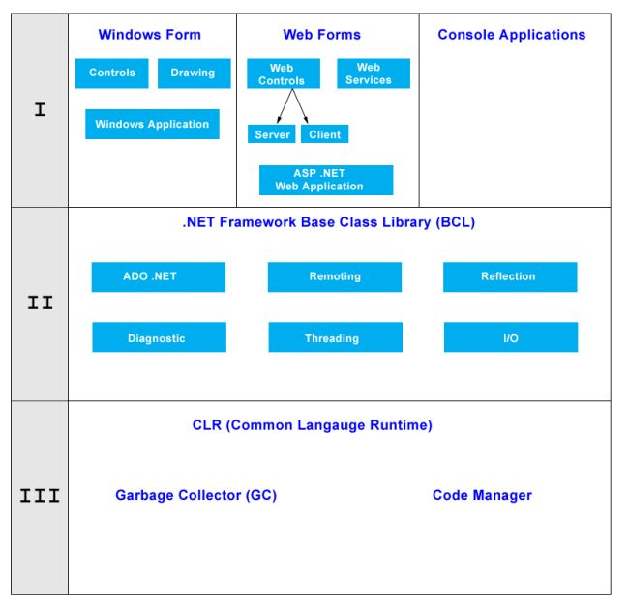
Architecture of .NET Framework

Slide 23
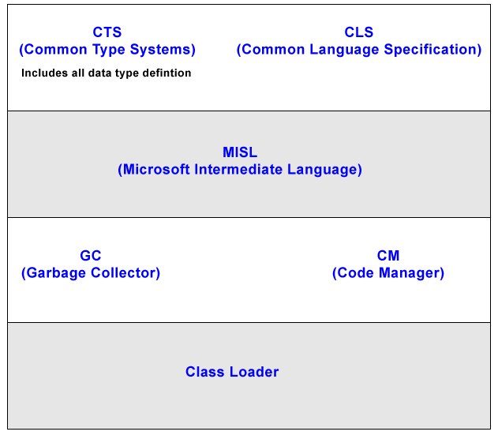
Architecture of CLR

Slide 24
Framework, Languages, And Tools
The .NET framework exposes numerous classes to the developer. These classes allow the development of rich client applications and Web based applications alike.
ASP.NET provides the core Web infrastructure such as Web Forms for UI based development and Web Services for programmatic interface development,
User interface development on the Windows platform can be done using Windows Forms
ADO.NET and XML provide the functionality for data access.
Finally, the core base classes provide infrastructure services such as security, transaction management etc.

Slide 25
Common Language Runtime
CLR is the run-time environment under which .NET programs are executed.
provides:
garbage collection
security
interoperability.
CLR is based on virtual machine with its own instruction set (like Java)

Slide 26
CIL – Common Intermediate Language
Into which programs written in any .NET language are translated.
CIL programs are compiled just before they run - just-in-time compilation (‘jitting’)
CIL interoperability between different languages and code portability
JIT compilation (just-in-time compilation) ensures that programs are efficient.

Slide 27
Compilation And Execution
Compilation
Assembly
Source Code
Language Compiler
Code (IL)
Metadata
Native
Code
JIT Compiler
At installation or the first time each method is called
Execution
Notes:
The diagram above illustrates the process used to compile and execute managed code, that is, code that uses the CLR. Source code written in C#, VB.NET, or some other language that targets the CLR is first transformed into MSIL by the appropriate language compiler. Before execution, this MSIL is JIT compiled into native code for whatever processor the code will run on. The default is to JIT compile each method when it is first called, but it’s also possible to “pre-JIT” the MSIL. With this option, all methods are compiled before the application is loaded, so the overhead of JIT compilation on each initial method call is avoided.
One point worth noting is that all languages targeting the CLR should exhibit roughly the same performance. While some compilers may produce better MSIL code than others, large variations in execution speed are unlikely.

Slide 28
Compilation And Execution
The diagram above illustrates the process used to compile and execute managed code, that is, code that uses the CLR. Source code written in C#, VB.NET, or some other language that targets the CLR is first transformed into MSIL by the appropriate language compiler. Before execution, this MSIL is JIT compiled into native code for whatever processor the code will run on. The default is to JIT compile each method when it is first called, but it’s also possible to “pre-JIT” the MSIL. With this option, all methods are compiled before the application is loaded, so the overhead of JIT compilation on each initial method call is avoided.
One point worth noting is that all languages targeting the CLR should exhibit roughly the same performance. While some compilers may produce better MSIL code than others, large variations in execution speed are unlikely.

Slide 29
Compilation in .NET
Code in VB.NET
Code in C#
Code in another
.NET Language
VB.NET compiler
C# compiler
Appropriate
Compiler
IL(Intermediate
Language) code
CLR just-in-time
execution

Slide 30
Native Code
The code to be executed must be converted into a language that the target operating system understands, known as native code. This conversion is called compiling code, an act that is performed by a compiler.
Under the .NET Framework, however, this is a two - stage process. With help of MSIL and JIT.

Slide 31
MSIL (Microsoft Intermediate Language)
It is language independent code. When you compile code that uses the .NET Framework library, you don't immediately create operating system - specific native code.
Instead, you compile your code into Microsoft Intermediate Language (MSIL) code. The MSIL code is not specific to any operating system or to any language.

Slide 32
JIT (Just-in-Time)
Just - in - Time (JIT) compiler, which compiles MSIL into native code that is specific to the OS and machine architecture being targeted. Only at this point can the OS execute the application. The just - in - time part of the name reflects the fact that MSIL code is only compiled as, and when, it is needed.
In the past, it was often necessary to compile your code into several applications, each of which targeted a specific operating system and CPU architecture. Often, this was a form of optimization.
This is now unnecessary, because JIT compilers (as their name suggests) use MSIL code, which is independent of the machine, operating system, and CPU. Several JIT compilers exist, each targeting a different architecture, and the appropriate one will be used to create the native code required.

Slide 33
Common Type System (CTS)
CLR defines a Common Type System that describes how classes, interfaces and primitive type are represented.
The CTS not only allows a class, implemented for example in C#, to be used in a Visual Basic .NET program, but even makes it possible for the C# class to be extended in Visual Basic .NET.
or an exception raised by a C# program can be handled by a program written in a different language.

Slide 34
Common Language Specification (CLS)
minimal subset of the CTS that all languages must support to use .NET’s language interoperability.
more than 20 such languages both from commercial providers and from universities.

Slide 35
Microsoft languages
C#
Visual Basic .NET
Managed C++
J++

Slide 36
Other languages:
Fortran
Eiffel
Java
ML
Oberon
Pascal
Perl
Python
Smalltalk
Zonnon
Managed C++, variant of C++ that is translated into managed code that runs under the control of CLR.

Slide 37
Cross Language integration
You can use a utility of a language in another language (It uses Class Language Integration).
.NET Framework includes no restriction on the type of applications that are possible. The .NET Framework allows the creation of Windows applications, Web applications, Web services, and lot more.
The .NET Framework has been designed so that it can be used from any language, including C#, C++, Visual Basic, JScript, and even older languages such as COBOL.

Slide 38
Verifier
When a program loaded and translated into machine code the CLR uses a verifier to check that the type rules of the CTS have not been violated.
For example, it is illegal to treat a number as an address and use it to access storage areas that belong to other programs.

Slide 39
Garbage Collector
.NET offers GC, which is responsible for reclaiming the storage of objects once they are no longer needed.
Avoid memory leak problem such as in C or C++.

Slide 40
Question
With Microsoft’s .NET it is possible to compose a program written in several different programming languages. Explain how it is possible and suggest an advantage.

Slide 41
The Base Class Library (BCL)
The class library of .NET
used by all .NET languages.
supersedes the current Windows APIs
still possible to call classical Windows functions.
BCL is divided into namespaces

Slide 42
Important namespaces
System.Collections: classes that manage collections of objects.
System.IO: contain classes for input and output
System.Threading: provides classes for parallel programming
System.Net : deals with network programming
System.Reflection: allows access to metadeta
System.Windows.Forms : concerned with GUI
System.XML: contains classes for creation and reading of data in XML.

Slide 43
ADO.NET
Comprises all the classes of the .NET library that are connected with accessing databases and other data sources such as XML files
predecessor technology called ADO (ActiveX Data Objects) only its name in common with ADO.NET.
object-oriented – structured and straightforward to use.
relational data model,
transactions
locking mechanisms.
independent of providers and database architectures.

Slide 44
ASP.NET
Deals with programming dynamic web pages.
Only its name in common with the predecessor technology ASP (Active Server Pages).
Programming model is fundamentally different.
Web pages are constructed dynamically on the server from current data and sent to the client in the form of pure HTML so that any web browser can display them.

Slide 45
ASP.NET(cont.)
contrast to ASP, ASP.NET uses an object-oriented model.
compiled language such as C# or Visual Basic .NET
not, as in ASP, interpreted language such as JavaScript or VBScript.
programs can take advantage of the entire class library of .NET.

Slide 46
Web Services
Web services are regarded as core of the .NET technology
They work via remote method calls using the protocols HTTP and SOAP (an application of XML).
Currently, Internet access is primarily through web browsers such as Google Chrome, Microsoft Edge, Mozilla Firefox, Safari, and Opera. Internet Explorer has been discontinued, and Netscape Navigator is no longer in use. Additionally, users access the internet through mobile apps, voice assistants, and IoT devices, expanding beyond traditional web browsing.
Web services allow a new style of co-operation between distributed applications that communicate without web browsers.
Calls and parameters are coded according to SOAP, an XML-based standard that is supported by most large firms.

Slide 47
What does .NET offer?
Robustness and safety
Type-checking and verification of CIL codes
garbage collector guarantees that there will not be any storage reclamation errors.
version stamping of assemblies permits DLLs with the same name to coexist and eliminates the overwriting of old DLLs by new ones. Some call it the end of ‘DLL Hell’.
Systems administrators can not only define access rights for individual persons (role-based rights) but also for particular parts of code (code-based rights),
Assemblies can be signed using public key cryptography so as to be sure that they are in their original form and have not be altered or extended later. This significantly reduces the problem of viruses.

Slide 48
What does .NET offer? (cont.)
Simple installation and de-installation of software
Software is installed under .NET simply by copying all the program files into a directory.
DLLs no longer have to be kept in a global system directory nor recorded in the Windows registry
De-installation is equally easy. The files are simply deleted from the disk.

Slide 49
Interoperability
Under .NET the various parts of a program do not all have to be written in the same language.
Managed C++ for the system level parts
C# or Visual Basic .NET for the user interface
ML for parts best expressed in a functional language.
Common Type System assists the development of software that is object-oriented and modular, extensible and easy to maintain.

Slide 50
Uniform software for desktop and Web
With .NET object-oriented programming is now also available for web programming in the same way as it has been around in desktop programming for many years. Web pages and their contents are objects with data and methods that can be used in server page code. Cryptic mixtures of HTML and script code, as are usual with ASP, are a thing of the past.
Web services, accesses to programs that run on remote computers appear as conventional method calls. Software development for desktop applications and web applications that have diverged in recent years come together again under .NET.

Slide 51
Standards
Although .NET technology originates from Microsoft, its core consists of several open standards that ensure cross-platform compatibility and interoperability.
ECMA Standard 335 (CLI) defines the Common Language Infrastructure (CLI), which includes the Common Language Runtime (CLR) and parts of the Base Class Library (BCL). These components enable multiple programming languages to run on different platforms.
ECMA Standard 334 (C# Standard) defines the C# programming language, ensuring consistency across different .NET implementations.

Slide 52
Standards (Cont..)
SOAP is based on the W3C standards for HTML and XML. It is itself presented as an IETF Standard (Internet Engineering Task Force) [SOAP]. WSDL will also become a W3C standard [WSDL].
UDDI is a de facto standard supported by more than 200 firms including Boeing, Cisco, Fujitsu, Hitachi, HP, IBM, Intel, Microsoft, Oracle, SAP and Sun [UDDI].

Slide 53
Differences from Java
.NET bears considerable resemblance to Java and so is often compared with it.
Based on a virtual machine that presents a run-time environment into whose code all programs are translated.
Whereas CIL programs are always translated into machine code, programs in Java bytecode are initially interpreted.
Java aims to support a single language on many different OS, .NET supports many different languages on a single platform.

Slide 54
Question
Explain how Java and Microsoft’s .NET are alike and in what respects they differ.

Slide 55
Answer
Both are intended to allow creation of component software. Both use a virtual machine: Java was designed for interpretation on e.g. web browser, .NET for just-in-time compilation. There is a time overhead for this compilation stage when the program is first loaded, but no time penalty at run time.
Java technology aims to make same language (Java) available on lots of platforms (through a virtual machine) whereas .NET makes many languages (at lease 20) available on the one platform of Windows (and also on Unix, Mac etc)

